Slide 1
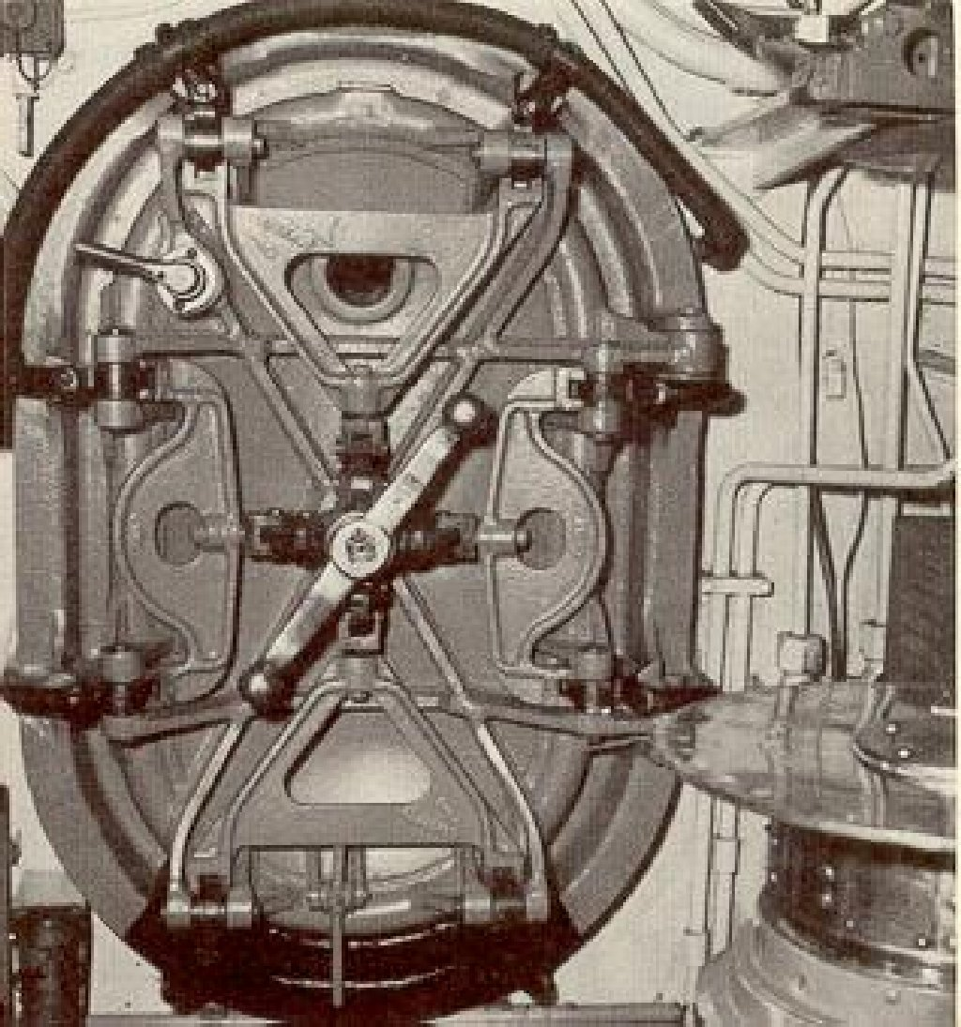
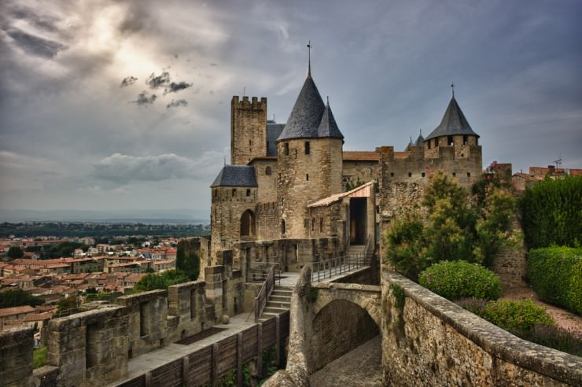
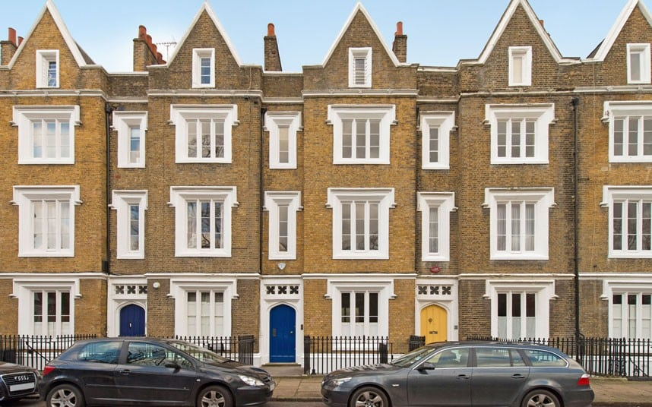
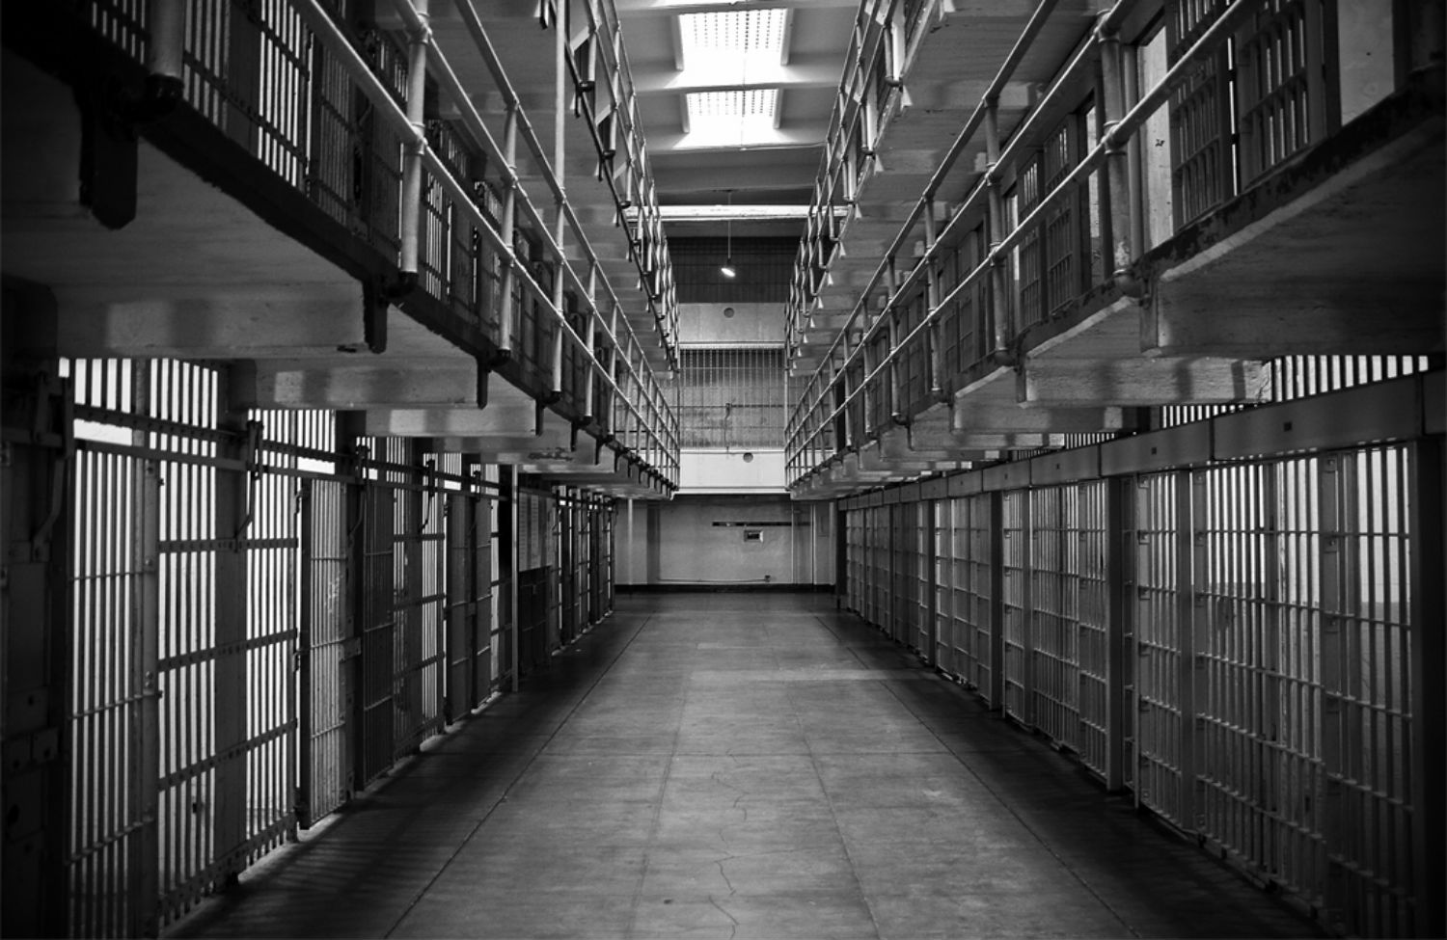
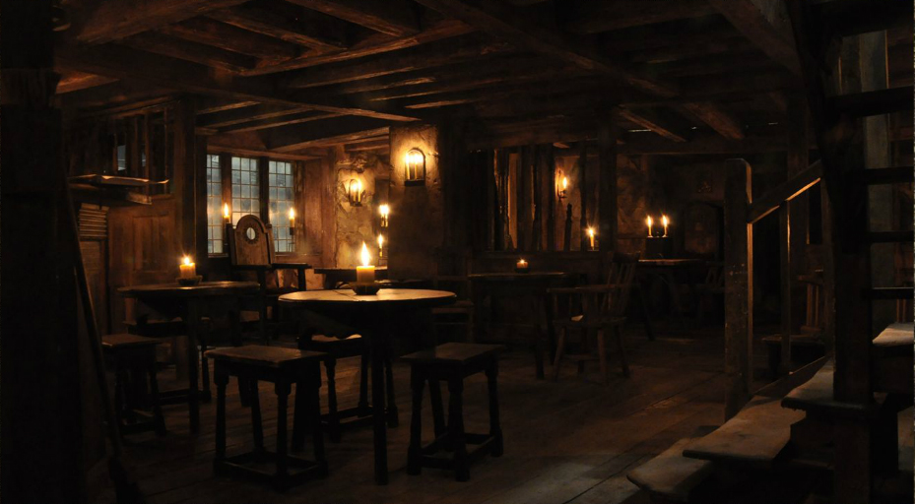
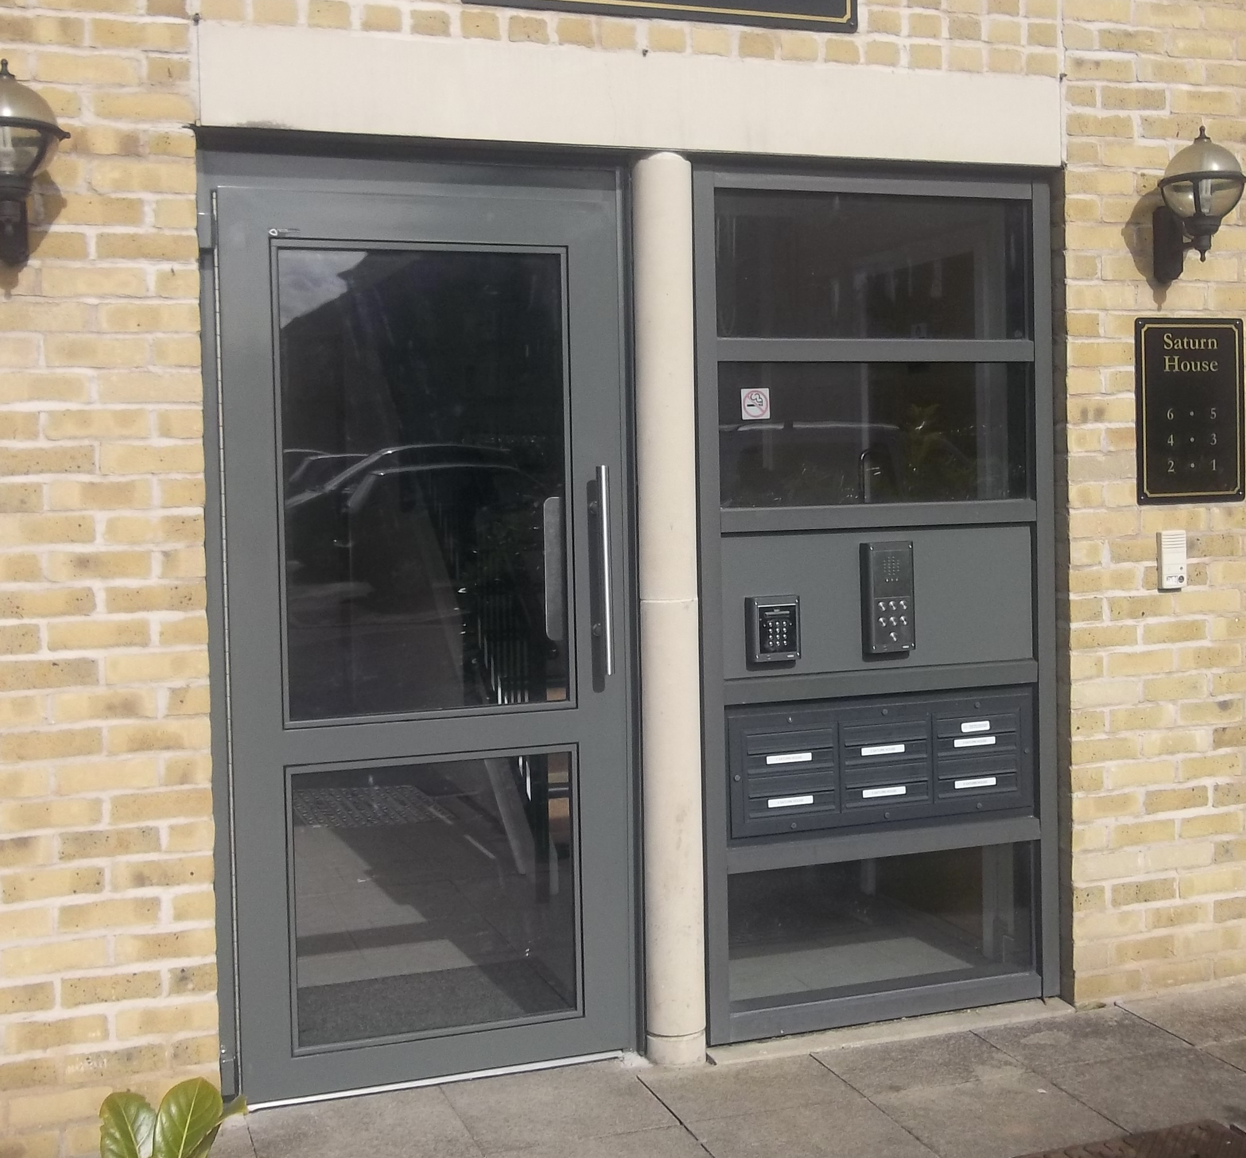
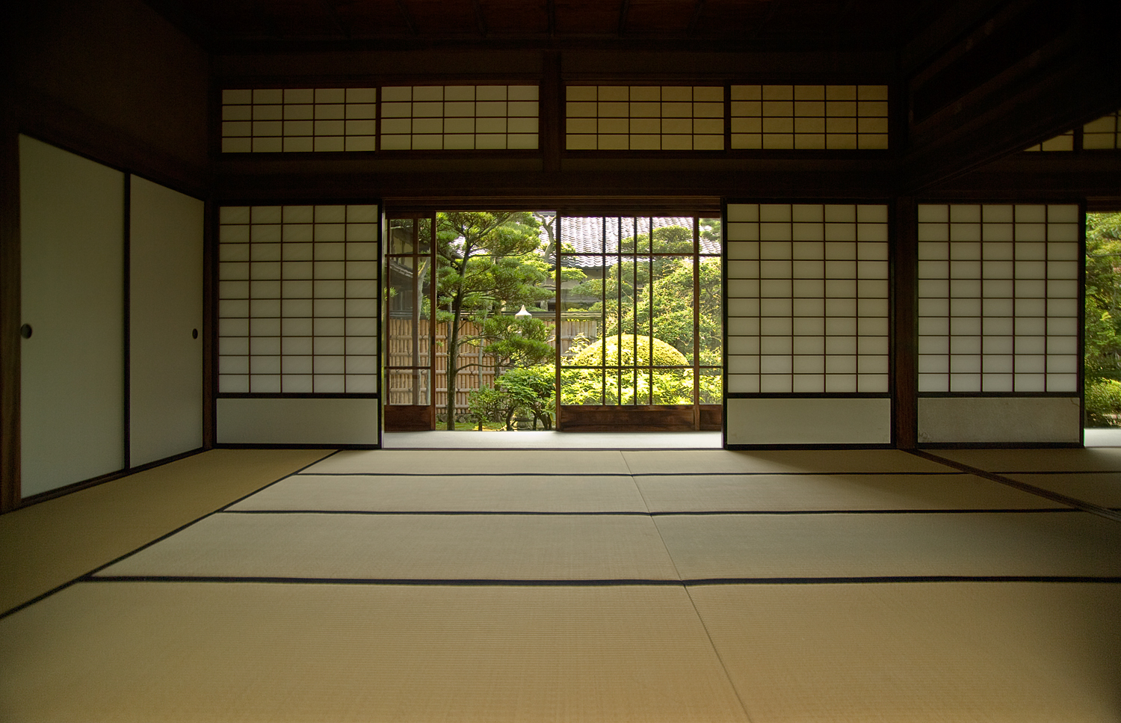
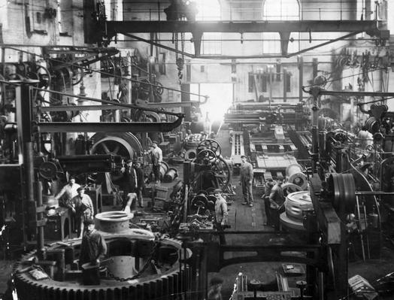
Castles were built during 1066 so that the Normans could remain safe and in control. This was fortified to assert power. The doors were strengthened with layers of wood as well.
In London there is little variation between doors on housing. Usually built of the same material.
Submarine door, strengthened with alloy steel and a unusual handle mechanic (Twist).
In prisons there are jail cell doors to keep people locked away. Usually horizontal and vertical bars.
Captains cabin on an old ship.
Traditional materials and sliding doors, used in the Japanese culture.
Machines were temperamental in the industrial revolution, they were dangerous. So usually in big factories metal doors were used to prevent fires spreading.
Modern day door, used for flats and office buildings. A communal entrance with a buzzer and keypad to use for entering.

